Slide 1
Hypothesis testing

Slide 2
Proposed explanation for a phenomenon
Proposition, claim, idea
Statement of what the researcher(s) predict will be the outcome of a study
A scientific hypothesis must be possible to test
A scientific hypothesis cannot deal with beliefs or morals
In science, a hypothesis is a prediction or explanation that is tested by an experiment. Experiments may disprove a scientific hypothesis, but can never entirely prove one.
Hypothesis
Notes:
Hypothesis testing involves formulating assumptions about population parameters based on sample statistics and rigorously evaluating these assumptions against empirical evidence. This article sheds light on the significance of hypothesis testing and the critical steps involved in the process.
What is Hypothesis Testing?
A hypothesis is an assumption or idea, specifically a statistical claim about an unknown population parameter. For example, a judge assumes a person is innocent and verifies this by reviewing evidence and hearing testimony before reaching a verdict.
Hypothesis testing is a statistical method that is used to make a statistical decision using experimental data. Hypothesis testing is basically an assumption that we make about a population parameter. It evaluates two mutually exclusive statements about a population to determine which statement is best supported by the sample data.
To test the validity of the claim or assumption about the population parameter:
A sample is drawn from the population and analyzed.
The results of the analysis are used to decide whether the claim is true or not.
Example: You say an average height in the class is 30 or a boy is taller than a girl. All of these is an assumption that we are assuming, and we need some statistical way to prove these. We need some mathematical conclusion whatever we are assuming is true.

Slide 3
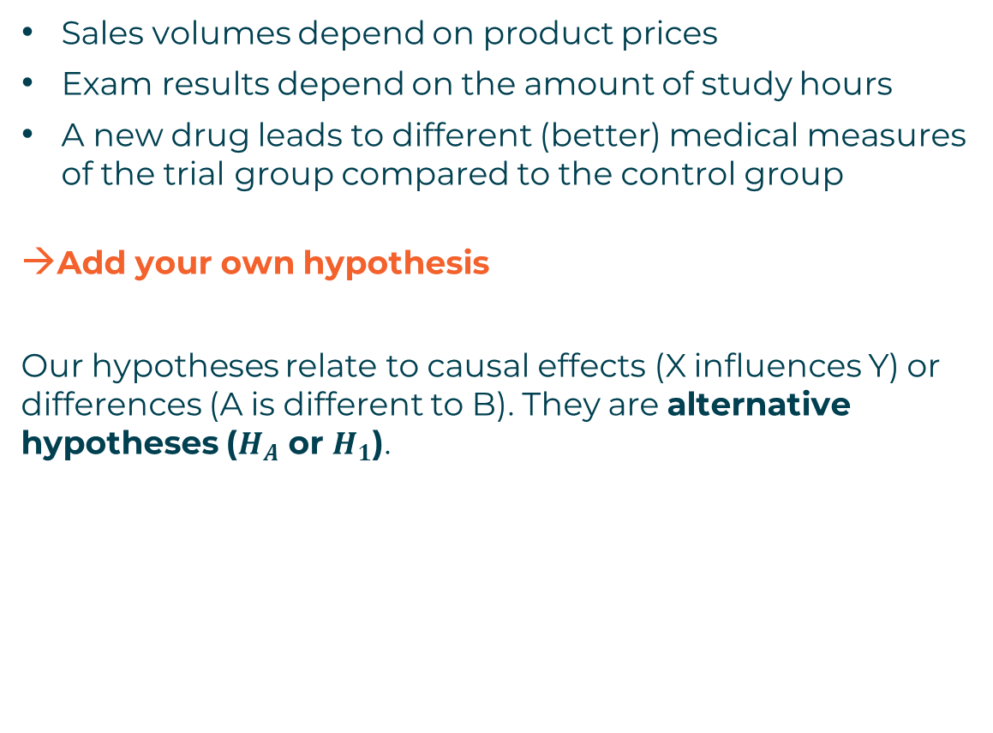
ALTERNATIVE HYPOTHESIS
Sales volumes depend on product prices
Exam results depend on the amount of study hours
A new drug leads to different (better) medical measures of the trial group compared to the control group
Add your own hypothesis
Our hypotheses relate to causal effects (X influences Y) or differences (A is different to B). They are alternative hypotheses ($H_{A}$ or $H_{1}$).
Notes:
Defining Hypotheses
Null hypothesis (H₀): In statistics, the null hypothesis is a general statement or default position that there is no relationship between two measured cases or no relationship among groups. In other words, it is a basic assumption or made based on the problem knowledge. Example: A company’s mean production is 50 units/per da H₀: μμ = 50.
Alternative hypothesis (H₁): The alternative hypothesis is the hypothesis used in hypothesis testing that is contrary to the null hypothesis. Example: A company’s production is not equal to 50 units/per day i.e. H₁: μμ ≠= 50.
The alternative hypothesis (H_{a}) is the other answer to your research question. It claims that there’s an effect in the population.
Often, your alternative hypothesis is the same as your research hypothesis. In other words, it’s the claim that you expect or hope will be true.
The alternative hypothesis is the complement to the null hypothesis. Null and alternative hypotheses are exhaustive, meaning that together they cover every possible outcome. They are also mutually exclusive, meaning that only one can be true at a time.
Examples:
Does tooth flossing affect the number of cavities?Tooth flossing has an effect on the number of cavities.
Does the amount of text highlighted in a textbook affect exam scores?The amount of text highlighted in the textbook has an effect on exam scores.

Slide 4
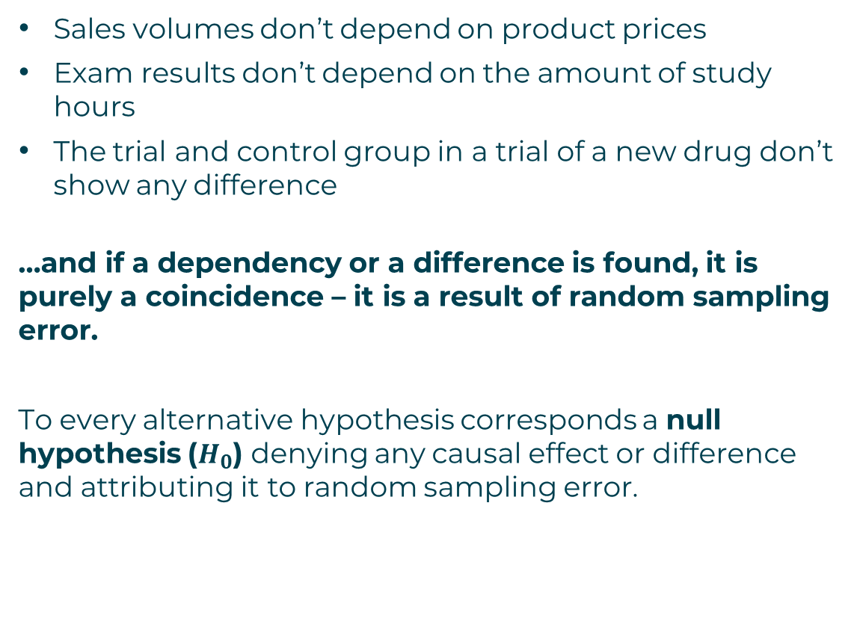
NULL HYPOTHESIS
Sales volumes don’t depend on product prices
Exam results don’t depend on the amount of study hours
The trial and control group in a trial of a new drug don’t show any difference
…and if a dependency or a difference is found, it is purely a coincidence – it is a result of random sampling error.
To every alternative hypothesis corresponds a null hypothesis ($H_{0}$) denying any causal effect or difference and attributing it to random sampling error.
Notes:
The null hypothesis is the claim that there’s no effect in the population.
If the sample provides enough evidence against the claim that there’s no effect in the population (p ≤ α), then we can reject the null hypothesis. Otherwise, we fail to reject the null hypothesis.
Although “fail to reject” may sound awkward, it’s the only wording that statisticians accept. Be careful not to say you “prove” or “accept” the null hypothesis.
Example: Population on trialThink of a statistical test as being like a legal trial. The population is accused of the “crime” of having an effect, and the sample is the criminal evidence. In the United States and many other countries, a person accused of a crime is assumed to be innocent until proven guilty. Similarly, we start by assuming the population is “innocent” of having an effect.
In other words, the null hypothesis (i.e., that there is no effect) is assumed to be true until the sample provides enough evidence to reject it.
Null hypotheses often include phrases such as “no effect,” “no difference,” or “no relationship.” When written in mathematical terms, they always include an equality (usually =, but sometimes ≥ or ≤).
You can never know with complete certainty whether there is an effect in the population. Some percentage of the time, your inference about the population will be incorrect. When you incorrectly reject the null hypothesis, it’s called a type I error. When you incorrectly fail to reject it, it’s a type II error.

Slide 5
Null and alternative hypothesis
Null hypothesis
(status quo)
Alternative hypothesis
(state of innovation)
Completely opposite
Rejecting one means accepting the other
The default position in a statistical test is that the null hypothesis is correct. The aim is to reject it.
Notes:
In other words, the null hypothesis (i.e., that there is no effect) is assumed to be true until the sample provides enough evidence to reject it.
Null hypotheses often include phrases such as “no effect,” “no difference,” or “no relationship.” When written in mathematical terms, they always include an equality (usually =, but sometimes ≥ or ≤).
You can never know with complete certainty whether there is an effect in the population. Some percentage of the time, your inference about the population will be incorrect. When you incorrectly reject the null hypothesis, it’s called a type I error. When you incorrectly fail to reject it, it’s a type II error.
What is an alternative hypothesis?
The alternative hypothesis (H_{a}) is the other answer to your research question. It claims that there’s an effect in the population.
Often, your alternative hypothesis is the same as your research hypothesis. In other words, it’s the claim that you expect or hope will be true.
The alternative hypothesis is the complement to the null hypothesis. Null and alternative hypotheses are exhaustive, meaning that together they cover every possible outcome. They are also mutually exclusive, meaning that only one can be true at a time.
TipBe careful with your words when you report the results of a statistical test in a research paper or thesis. If you reject the null hypothesis, you can say that the alternative hypothesis is supported. On the other hand, if you fail to reject the null hypothesis, then you can say that the alternative hypothesis is not supported. Never say that you’ve proven or disproven a hypothesis. Alternative hypotheses often include phrases such as “an effect,” “a difference,” or “a relationship.” When alternative hypotheses are written in mathematical terms, they always include an inequality (usually ≠, but sometimes < or >). As with null hypotheses, there are many acceptable ways to phrase an alternative hypothesis.

Slide 6
Error types
Type 1 error
(false positive)
H0 true but rejected
Correct
H0 false and rejected
Type 2 error
(false negative)
H0 false but accepted
Correct
H0 true and accepted
Notes:
In reality H0 is true or not. Our conclusion to accept or reject H0 either matches the reality or not.
If H0 is true and we have concluded we accept it, our conclusion is correct.
If H0 is false and we have concluded we reject it, our conclusion is correct.
If H0 is true and we have concluded we reject it, this is Type 1 error, also known as a “false positive”. Thhis is the error of accepting an alternative hypothesis when the results can be attributed to chance. We are observing a relationship or difference when actually there is none (or it is not statistically significant).
If H0 is false and we have concluded we accept it, this is Type 2 error, also known as a “false negative”. We are failing to observe a relationship or difference when in reality there is one.

Slide 7
Hypothesis testing is a way to analyse the results of a survey or experiment to see if they are meaningful (significant).
The testing must determine whether the results are significant by estimating the probability that they have happened by chance (i.e., that the null hypothesis can be accepted).
If there is high enough probability that the results have happened by chance, the experiment and its results won’t be repeatable and so our alternative hypothesis cannot be accepted. In this case, the null hypothesis is accepted.
If the probability that the results have happened by chance is small enough, then the null hypothesis is rejected, and therefore the alternative hypothesis is accepted.
HYPOTHESIS testing

Slide 8
Hypothesis testing consists of the following main steps:
Formulate the null hypothesis and the alternative hypothesis.
Collect data sample(s) to test the hypothesis.
Perform an appropriate statistical test.
Decide whether to reject or accept the null hypothesis.
Present the results.
HYPOTHESIS testing steps

